Slide 1
Introduction to
Accessible Communication
2018
KATS Network/Office of Vocational Rehabilitation
Notes:
Good morning everyone. Welcome to the first of our webinar series on Accessible Communication. The series is sponsored by the KATS Network and the Kentucky Office of Vocational Rehabilitation. Today, we are going to give a brief overview of accessible communication. Future webinar topics will teach you how to make your documents accessible.
It’s pretty easy to think about “accessibility” in buildings. We are all familiar with parking and ramps and accessible bathrooms. Most of us don’t worry about these things when it comes to our work spaces – because that is “someone else’s “ responsibility. They are things that are just there in our environment and we don’t notice them unless they are missing and we need them.
However, accessible communication is a little harder subject to nail down and maybe something that you haven’t really thought about as you go through your day. Today we are going to discuss what accessible communication really is.

Slide 2
What is “accessible” communication ?
An exchange of information that is able to be obtained, understood, and used by everyone.
Notes:
So, what is “accessible” communication? “Accessible” communication is an exchange of information that is able to be obtained, understood, and used by everyone – regardless of their background and limitations (or disability).
In the Office of Vocational Rehabilitation, we may think that we are good at this, because we always make sure to communicate with people in a way that they can understand and we can understand back. And when we are talking about verbal face-to-face communication, we are really good at that. If I am communicating with someone who is deaf, I might use an interpreter, or a relay service, or maybe even just send an email or text message. If I am communicating with someone with an intellectual impairment, I will make sure that I use language that they can understand.
When we are talking about electronic communication, the concept of accessibility is maybe a little harder – and one reason is that you don’t always know who your audience is.
Let me give you an example. If you are a vocational rehabilitation counselor with the Office of Vocational Rehabilitation, one of the jobs you do, probably on a daily basis, is make case progress notes. Some people type these notes and some people write them by hand. And really, who is the main recipient of this communication? Well, the main recipient is you – the whole reason you make those notes is to document what is happening in the case so you can review it and remind yourself later. And then, your supervisor may review this case and need to read the progress notes. And if you want to spend a lot of money on the case, or provide a service that requires an exception, the director of program services may need to review the notes as well. And you are thinking – well, it’s fine – my supervisor and executive leadership read my notes all the time and it isn’t a problem. Now think ten years down the road – your consumer’s case has been closed a long time and you have retired. The case file has been scanned and archived, but it is available, along with all your notes, in the archive file. The consumer comes back to OVR for more help and her case is assigned to the person who replaced you. Do you know now who the new counselor is? Of course not, it’s likely they are still in middle school. What if that person has a visual impairment that prevents them from being able to read your progress notes? Is there information in your progress notes that is not available anywhere else? How will that person be able to access the notes? Should they have to ask someone to sort through and read the notes to them? Because that is what happens now. When a counselor with a visual impairment takes on an existing caseload with handwritten notes, there is no other option.
The problem is, even when we know who our current audience is, we all generate documents that may need to be read by someone else in the future. And as soon as those documents are scanned into an archive file that may have to be accessed by another person, they become “electronic” communication and they are required (by law) to be accessible.

Slide 3
Disability
The Americans with Disabilities Act defines a person with a disability as a person who has a physical or mental impairment that substantially limits one or more major life activity.
  Includes people who have a record of having a disability or are regarded as having a disability.
“Disability” is experienced by different people in different ways – it depends upon personal, social, environmental, and cultural factors.
  While people experience disability differently – and in a whole range of severity – when we plan for our communication to be accessible, it can be accessible to everyone, regardless of how they experience disability.
Notes:
“Disability” is one factor that can affect how well an individual is able to receive, understand, or express ideas. But what is disability?
The ADA defines a person with a disability as a person who has a physical or mental impairment that substantially limits one or more major life activity. This includes people who have a record of such an impairment, even if they do not currently have a disability. It also includes individuals who do not have a disability but are regarded as having a disability.
Disability is actually more about how an individual’s functional limitations interact with the personal, social, environmental and cultural factors. For example, someone with some hearing impairment may be unable to distinguish speech in loud environments, but may be more able to understand and participate in a conversation in a quiet area. Based on all these factors, people experience disability differently – and in a whole range of severity. When we plan for our communication to be accessible, it can be accessible to everyone, regardless of how they experience disability.

Slide 4
Types of Disability by Functional Activity Type
Vision
  Blindness, low vision, color blindness
Auditory
  Deafness, hard of hearing
Motor
  Paralysis, spasticity, weakness, missing/damaged limbs, range of motion limitations, dexterity, pain, fatigue
Cognitive
  Learning disabilities, autism, intellectual disabilities, developmental delays/disabilities, neurodegenerative disabilities, brain injuries
Mental Health
  Anxiety, Depression, Bi-polar
Notes:
When you think about the physical accessibility of a building, it’s most likely you think about individuals who have motor impairments – and mostly those who use wheelchairs for their mobility. When you think about accessible communication, face-to-face, you might think about someone with a hearing impairment. And when you think about someone accessing the computer or written communication, you might think about someone with a visual impairment.
But it is important to realize that people experience all different types of disability, some of which are listed on the slide.
Someone with a visual impairment could be blind, or have limited vision. They could also experience difficulty with communication just because they are color blind.
There are a large range of hearing impairments as well – someone with slight impairment, as mentioned before, may just have difficulty conversing in a noisy area, but others may be deaf.
I include many different areas in the “motor” category of disability. Most people may think of paralysis and amputations or missing limbsssing a limb, but this category also encompasses things like muscle weakness, limitations in range of motion, dexterity issues, or spasticity. I also group disabilities in this area that cause pain and fatigue.
Cognitive limitations also come in a wide range, including learning disabilities, autism, intellectual disabilities, developmental delays and disabilities, neurodegenerative disabilities, and brain injuries.
Mental health limitations also include a wide range – some of the disabilities I see most often in this category are anxiety, depression, and bi-polar.
It may not be immediately obvious, but all of these systems play a part in our ability to communicate effectively. As in the case we discussed a few minutes ago, someone who is blind may not be able to effectively read archived notes. Someone with hearing loss may not be able to listen to a recorded training sessions. A person with a motor impairment, may not have the dexterity to sort through the pages of a file. A person with a learning disability may not be able to read even typed notes independently. An individual with anxiety may not be able to concentrate on the written word effectively enough to get information.
It is our job to make sure our communication allows the widest access to information.

Slide 5
The Law:
The Rehab Act of 1973:
  Section 504 (non-discrimination under Federal grants and programs)
  Section 508 (accessible Federal information technology)
Americans with Disabilities Act of 1990 – requires accessibility of programs, services, public accommodations and employment
Kentucky Accessible Information Technology Law (2000) – accessible KY state information technology
Notes:
Accessible communication may not be the first thing you think about when you think about the laws around accessibility. The Americans with Disabilities Act is a well-known law that was passed in 1990. We often think of this law as requiring non-discrimination in hiring (Title I), and physical accessibility of public accommodations like stores and restaurants (Title III), and those of us working for state and local governments know that our services must be accessible to people (Title II). People may not know the exact accessibility guidelines governing buildings, but they are in general aware that there are guidelines to be followed. But accessibility doesn’t end with the physical accessibility of a building.
We can go back to 1973 and the Rehab Act, Section 504, which requires non-discrimination under Federal grants and programs. Section 508 deals specifically with the accessibility of information technology purchased by the federal government. Of course, we didn’t really have common usage of desktop computers in 1973 – so the law doesn’t directly address, for example, documents created using Microsoft Word because it didn’t exist in 1973. But the requirement for accessibility is there.
And the Kentucky Accessible Information Technology law was passed in 2000 – and requires that any underlying operating system used for the manipulation and presentation of information shall permit the installation and effective use of nonvisual access software and peripheral devices. This means that when we scan a file into our archives, we are required to ensure that someone using assistive technology can access those files.
Communication, is a large part of everything we do – from applying for jobs, to buying and selling merchandise, to providing job training, and to governing. In order for these things to be accessible, the communication about these things has to be accessible.
We don’t have formal regulations that tell us exactly what makes an electronic document accessible, but that has not stopped the courts from addressing the issue of electronic accessibility. The courts have been fairly consistent in requiring that electronic communication be accessible.

Slide 6

Barriers
Notes:
Accessibility is really the same concept, whether we are referring to physical accessibility or communication accessibility. It’s easy to see when a building is not physically accessible. When you look at the picture of this house design on the screen, you can see that the four steps leading to the entrance of the home would present a barrier to a person with a mobility impairment. There is no need to make any changes to the home if there is no one that lives there or ever visits there that can’t walk up and down steps, right? Well, until there is someone – a friend who wants to visit who uses a wheelchair or your elderly parent with a bad hip and knee - or even yourself when you break your ankle doing cartwheels to prove that you still can. Now we are aware of the barrier and it triggers us to respond and develop a solution to help individuals with motor impairments enter the home.
In the same way, when we generate a document that someone is unable to read, we may be completely unaware that it is inaccessible until someone tries to access it and can’t, and then points it out to us.
Another note here on barriers – are the steps in the picture only a barrier to a person with a motor impairment? No. They are also a barrier to a parent pushing a stroller, a person trying to carry several bags of grocery into the house, or a child trying to take their bike out to ride. The difference, of course, is that a parent can take the child out of the stroller and carry him up the steps and then later come back for the stroller, the person carrying several bags can leave some at the bottom of the steps and make several trips, and at least my boys would just ride their bikes down the stairs anyway – but the person who is unable to walk cannot jump up the steps and come back later for the wheelchair.

Slide 7
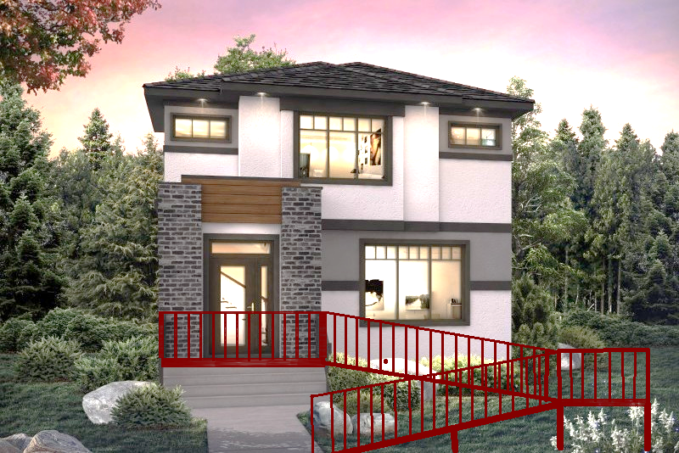
Accommodation
Notes:
So, when there is a barrier, we look for an accommodation. When we encounter steps to enter a home for an individual with a mobility impairment, we often add a ramp to allow the individual to independently get in and out of their homes, a shown in the picture on the screen. This type of accommodation does the job, but it is not always an elegant solution or one that is really helpful to all people. Think about a person with a bad hip who has a difficult time walking long distances. While they may be able to use the ramp to get to the front door, it adds the number of steps that need to be taken to get there.
In looking at communication, this is the equivalent of providing a specially designed document that can be accessed with a screen reader when the original document is not accessible. We are making an accommodation for the individual with a disability to provide them access to the information. Or maybe, it is just modifying a form so that it works for a person using a screen reader, without regard to whether or not that same form would be accessible to an individual who has a learning disability. We have provided an accommodation that allows an individual with a specific disability to access the form.

Slide 8

Accessibility
Notes:
When we have the opportunity, we really want to strive for accessibility from the start. The picture of the screen now shows the same house, with the same floor plan, except that the steps at the entrance have been removed from the design. Someone with a mobility impairment can enter the home through the front door without having to use a ramp. Accessible architecture allows all people to enter the home without the need for an accommodation. When we start with accessibility as a goal from the start, we end up with a better design.
Accessible communication works the same way; one document – email, web-based, Word, Excel, PowerPoint , PDF and so on – is usable and accessible to all people.

Slide 9
What communication has to be accessible?
“technologies” that provide access to information
  Internet & websites
  Phones
  Computers
  Online training
  Computer generated documents: Word, PDF, PowerPoint and so on
  Email
  Videos, webcasts, webinars
Notes:
Hopefully, you have an idea of what we are trying to achieve. We want all communication, whether it be for employees or public-facing, to be accessible. For state and local governments – the requirement is that programs and services must be accessible – and this includes the communication that goes along with the programs and services. In this series of webinars we are going to talk about specifically “electronic” communication – which is typically accessed by a computer or mobile device and includes websites, online training that employees receive, computer-generated documents, like Word files, PDFs, PowerPoints, and emails. It also includes “media”, like videos, webcasts, or webinars. It also includes the technology, like computers and telephones, that we use to generate the information.
While we are talking about “electronic” documents and communication, remember that a document that is more accessible electronically is likely to also be more accessible if it is printed out on paper. Many of the same principles will apply to paper documents as electronic documents. Additionally, you don’t really know when an individual is going to need to use a “device” to access information on a piece of paper. By following general accessibility guidelines, it will make it easier for the person using technology to access the paper document as well.
Which bring us back to that progress note – you might be thinking that a hand-written note is not an electronic communication. And you are correct, when it is in written format, it is not an electronic document. As soon as you scan it into our Case Management System, it becomes a PDF, which is an electronic document.
Another note – when we purchase a service and report (for example, a driver evaluation), and we receive the report in electronic format (it is emailed to us), the report must be accessible. It is the responsibility of the vendor to provide us with an accessible document – we can require that the vendor provide us with an accessible report. And if we get a paper copy report that we then upload into CMS, it is our responsibility to make sure that the document is accessible. OVRs driver rehabilitation program does require our vendors to submit reports in an accessible format.

Slide 10
How is this relevant to me?
All communication generated by the state must be accessible. If you are a state employee or you accept state or federal funds to provide the communication, you are “the state.”
Just because someone else releases information that is not accessible, doesn’t mean that you should.
It doesn’t matter if the communication is “just internal” – the law applies to both internal and public facing documents.
Notes:
How is this relevant to me? The thing about accessible communication is that it starts at the individual communicator level. It’s not like a ramp – you or I may not have the “power” to get a ramp put in where a step exists. But we both have the power to generate our own accessible documents. And while we can discuss whether or not the rules apply to you, we can’t debate the fact that access to information is certainly a civil right. And all communication generated by the state must be accessible. If you are a state employee or if you accept state or federal funds to provide the communication – that communication must be accessible.
When I was talking to someone from an “area development district,” they told me that they didn’t have to make their documents accessible, because the state itself releases electronic communication all the time that is not accessible. And, unfortunately, it is true that the state releases inaccessible materials – from websites to internal emails about the weather. After a short demonstration, he agreed, though, that the information he wanted to share was not usable by a person with a visual impairment. I think he just didn’t realize how the document “appeared” (so to speak) to someone who couldn’t see it. Once he understood, however, he made an effort and changed what he was doing to improve accessibility. And the fact of the matter is, he, individually, without the help of the state or changes made at a high level, was able to affect the accessibility of the material he was presenting.
Another excuse I have heard is, “That was not intended for everyone. I thought it only went out to Cabinet staff.” Well, even if it did only go out to cabinet staff, the requirement for accessibility is still there. If it is important enough to send out to the whole cabinet, then it is important enough to make it accessible to everyone, including those who may have difficulty with an inaccessible document. The law applies to both public facing documents and internal documents.

Slide 11
What makes communication accessible?
Perceivable
Operable
Understandable
Robust
Notes:
It’s important to understand what “accessible” means when related to communication. Accessible communication is perceivable, operable, understandable, and robust. We use the acronym POUR when discussing electronic communication. Let’s talk about each of these characteristics.

Slide 12
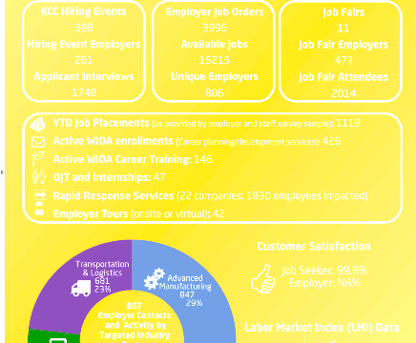
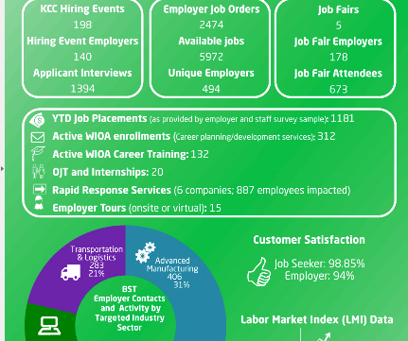
Perceivable
Perceivability means that the user can identify content and interface elements by means of the senses.
In this document, it doesn’t matter if it is electronic or printed, it is hard to see the information.
Notes:
First, we want to make sure that the communication is Perceivable. This means that the information you are communicating is perceivable in multiple ways – by sight, by hearing, and by touch. We want all the information communicated to be accessible to anyone who uses the document. This means, for example, that a printed document should meet some basic criteria for perceivability , like good contrast and font style and size, good quality printing, and include plenty of white space. These characteristics will make it easy to read for anyone and also will make it easy to use assistive technology to scan and read it out loud to someone who is unable to see or read. If the document is not distributed electronically, it’s also best practice to have this document available in an alternate format for those who are unable to access print. Accessible electronic versions of the document can make it easy for someone to access regardless of the assistive technology they use.
Look at the two examples of printed documents on the slide – they are nearly identical in design. A good font style and size have been chosen, and there is plenty of blank space around the information, the information is grouped together, but the person who developed this document missed one important point – white print on a yellow background is almost unreadable – even to someone without a visual impairment. And that is as true when the document is printed as it is when it is accessed electronically. Luckily, the person who made these documents asked for an evaluation of their accessibility and fixed the issue before he distributed it.

Slide 13
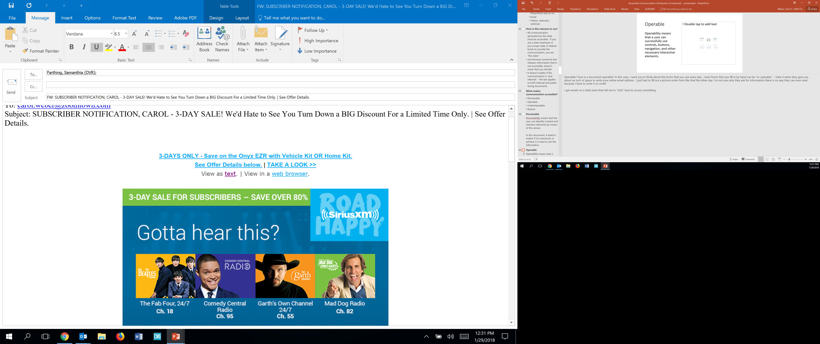
Operable
Operability means that a user can successfully use controls, buttons, navigation, and other necessary interactive elements.
Notes:
Operable? How is a document operable? In this case, I want you to think about the forms that you use every day – even forms that you fill in by hand can be “in-operable.” I hate it when they give you about an inch of space to write your entire email address. I just had to fill out a picture order form like that the other day. I’m not sure why they ask for information there is no way they can even read because I have to write it so small!
Something we all use every day, though, is email. I get emails on a daily basis that tell me to “click” here to access something – and the emails have a varying range of accessibility. This particular email, even though it is primarily a picture, has a link to “View as Text”, so someone using a screen reader could potentially use the screen reader to navigate to a page on the internet that was accessible. Screen readers give the user the option to read just the links on the page – and the link on this page would say “text”, allowing the user to click on it and navigate to a page with the information from the email, so the “text” link actually does make the email “more” accessible. This particular email is one of those cases where someone has taken a document and provided “accommodations” to improve accessibility – a separate document that is more accessible to someone using assistive technology to access the document.
You will see later through a demonstration of screen reader usage, why the “accommodation” is not as ideal as just having an accessible document to begin with - but what I want you to think about is time and complexity. It’s one thing to be able to get information in an email as I scroll through my emails to see what is available. It’s way more time consuming and complex to have to go to the internet to see what an email is about and then navigate back to the email screen to continue scanning emails.

Slide 14

Understandable
The sky is blue.
The firmament that encompasses this terrestrial realm appears a luminous cerulean.
Understandable means that it can be easily read and understood.
Notes:
Let's say that our communication is perceivable and operable by all kinds of users of all abilities, but it is understandable to none of them. Is the communication accessible? Of course not. Understandability can be just as big a barrier to accessibility as any of the more technical issues.
Most of the information on our documents is communicated through language. The language should be as easy to understand as possible. The wording as well as the words should be simple and concise. That is not to say that every document you generate should be readable to someone with a second grade reading level. That wouldn’t make sense – how could you communicate technical information in that way? But the principle of understandability does mean that you should consider your audience and write in terms that do not overly complicate the subject matter.
Look at the example on the screen – all three examples actually give the reader the same basic information. The first sentence on the right say simply, “The sky is blue.” The picture shows a blue sky. Having the information available in multiple ways assists people with understanding the information. The second sentence says, “The firmament that encompasses this terrestrial realm appears a luminous cerulean.” And certainly, the second sentence gives more detail by referring to a specific color of blue. And it is probably more technically correct (is the sky really blue, or does it just look that way?). But, to the audience, which segment of communication conveys the intended meaning?
Providing alternative or supplemental representations of information can often increase understandability. Text can be supplemented with illustrations, videos, animations, audio, and content in other alternative formats. In fact, for some people with more severe cognitive disabilities or people with reading disabilities, these alternative formats may be necessary for comprehension. Providing summaries or abstracts of lengthy content can also make it more understandable.

Slide 15
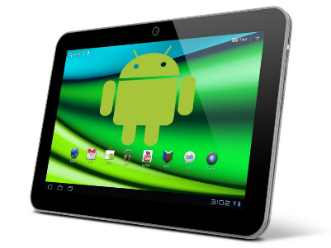
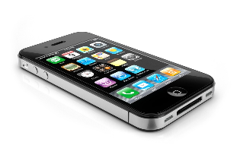
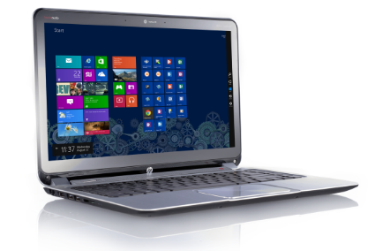
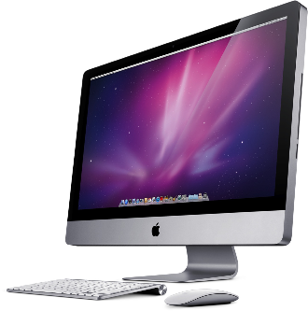
Robust
Robust communication is designed to get information to the users regardless of the technology employed to access the information.
Notes:
Robust communication is designed to get information to users regardless of the technology they employ. It’s easy to see when a webpage is not “robust” when we have to go to a desktop computer to access or interact with the page, instead of being able to access it with our phones.
Many of us may not work directly on web pages, but this specification still applies to our documents. For example, if a Word document is accessible, it will be as easy for a person using a screen reader to access it as it is for a person with ADHD.
When communication is robust, all sorts of assistive technology can work with the communication to allow people to access it.

Slide 16
General Accessibility Features

Slide 17
Plain Language: Before
When the process of freeing a vehicle that has been stuck results in ruts or holes, the operator will fill the rut or hole created by such activity before removing the vehicle from the immediate area.
Notes:
When communicating, it is important to use plain language. Look for ways of saying things that get the information across in an easy to understand way.
Here is an example of language that is more complex than necessary for getting a point across:
When the process of freeing a vehicle that has been stuck results in ruts or holes, the operator will fill the rut or hole created by such activity before removing the vehicle from the immediate area.

Slide 18
Plain Language: After
If you make a hole while freeing a stuck vehicle, you must fill the hole before you drive away.
Notes:
The same thing can be said with fewer words and more directly by simply stating:
If you make a hole while freeing a stuck vehicle, you must fill the hole before you drive away.

Slide 19
Color Contrast
The quick brown fox jumps over the lazy dog
The quick brown fox jumps over the lazy dog
Notes:
Contrast is an important concept – we saw an example of an extreme situation early – with white text on a yellow background. Here is a more simple illustration of the concept.
The top line – black on a white background meets accessibility standards. The light gray text on the same white background is not accessible. In fact, if a document with this color text was scanned for optical character recognition, it is possible that the software recognizing the text would miss this light colored text altogether.

Slide 20
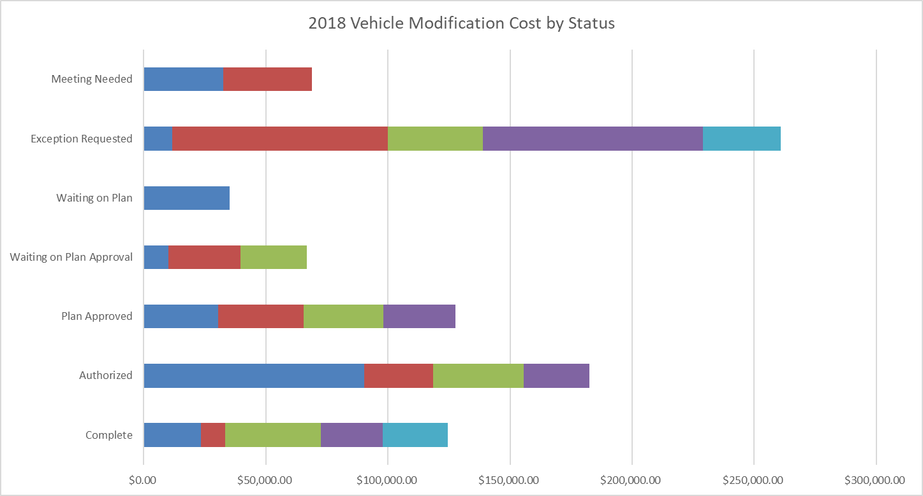
Color and Information
Notes:
The purpose of this graph is to let someone know at a glance about the upcoming costs of vehicle modifications. It shows seven different stages of the vehicle modification process and the number of cases in that status with an approximate or estimated cost of each modification. For example, when I look at it, I can see that there are 5 vehicles in the “exception requested” category, and that the total expected cost of those modifications is about $260,000. I can see that two of the modifications are about $90,000 each. The purpose of the graph is not to provide precise information, but just a general sense of where we are fiscally with vehicle modifications. While this information all “looks” good – someone who is color blind may have difficulty getting the same information. As bright and bold as these colors seem, they fail the color contrast test.

Slide 21
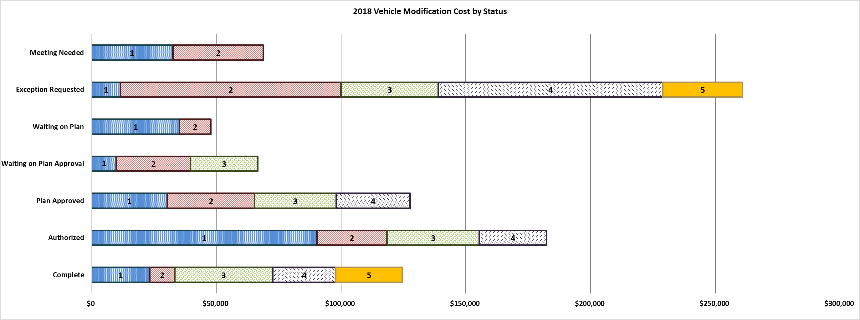
Provide Information with more than just color
Notes:
This graph gives exactly the same information, but the information is displayed in a slightly different way. Each color bar, for example, is outlined in a darker color to allow distribution. The bars are each numbered so that I can simply look in the last bar to see how many modifications are in that status. The bars also have a “texture” to each color – so not only are the colors different, but the texture is also different, making it easier to identify which color is which.
It is difficult to find colors in this type of graph that meet the color contrast requirements for accessibility. That is one reason that it is important to find other ways to communicate the information.
Another helpful way to make this graph more accessible would be to provide a narrative description of the graph. You might think – why include the graph at all since a graph like this would not be accessible to a screen reader. The idea is that you want to provide information in as many ways as possible.

Slide 22
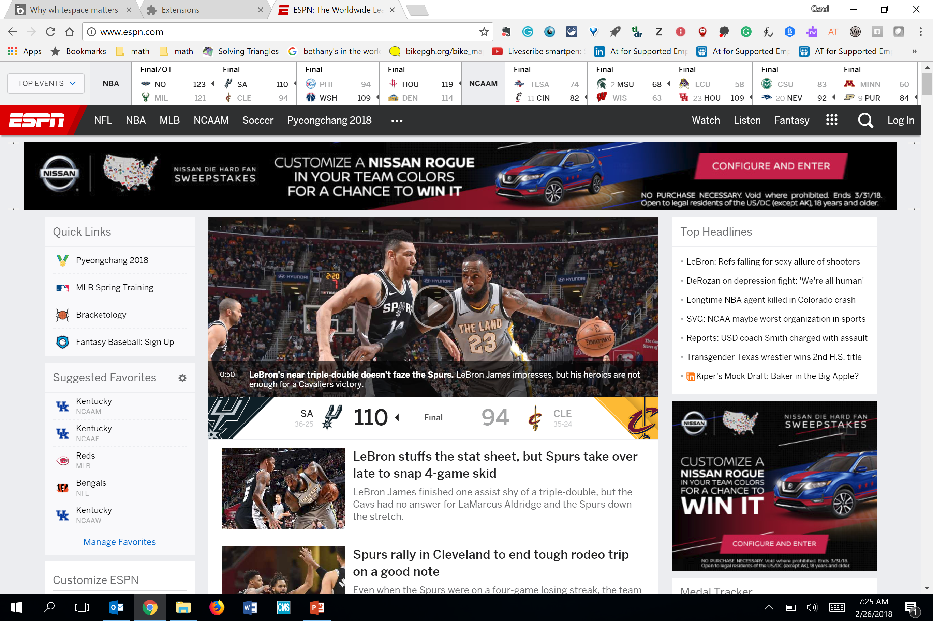
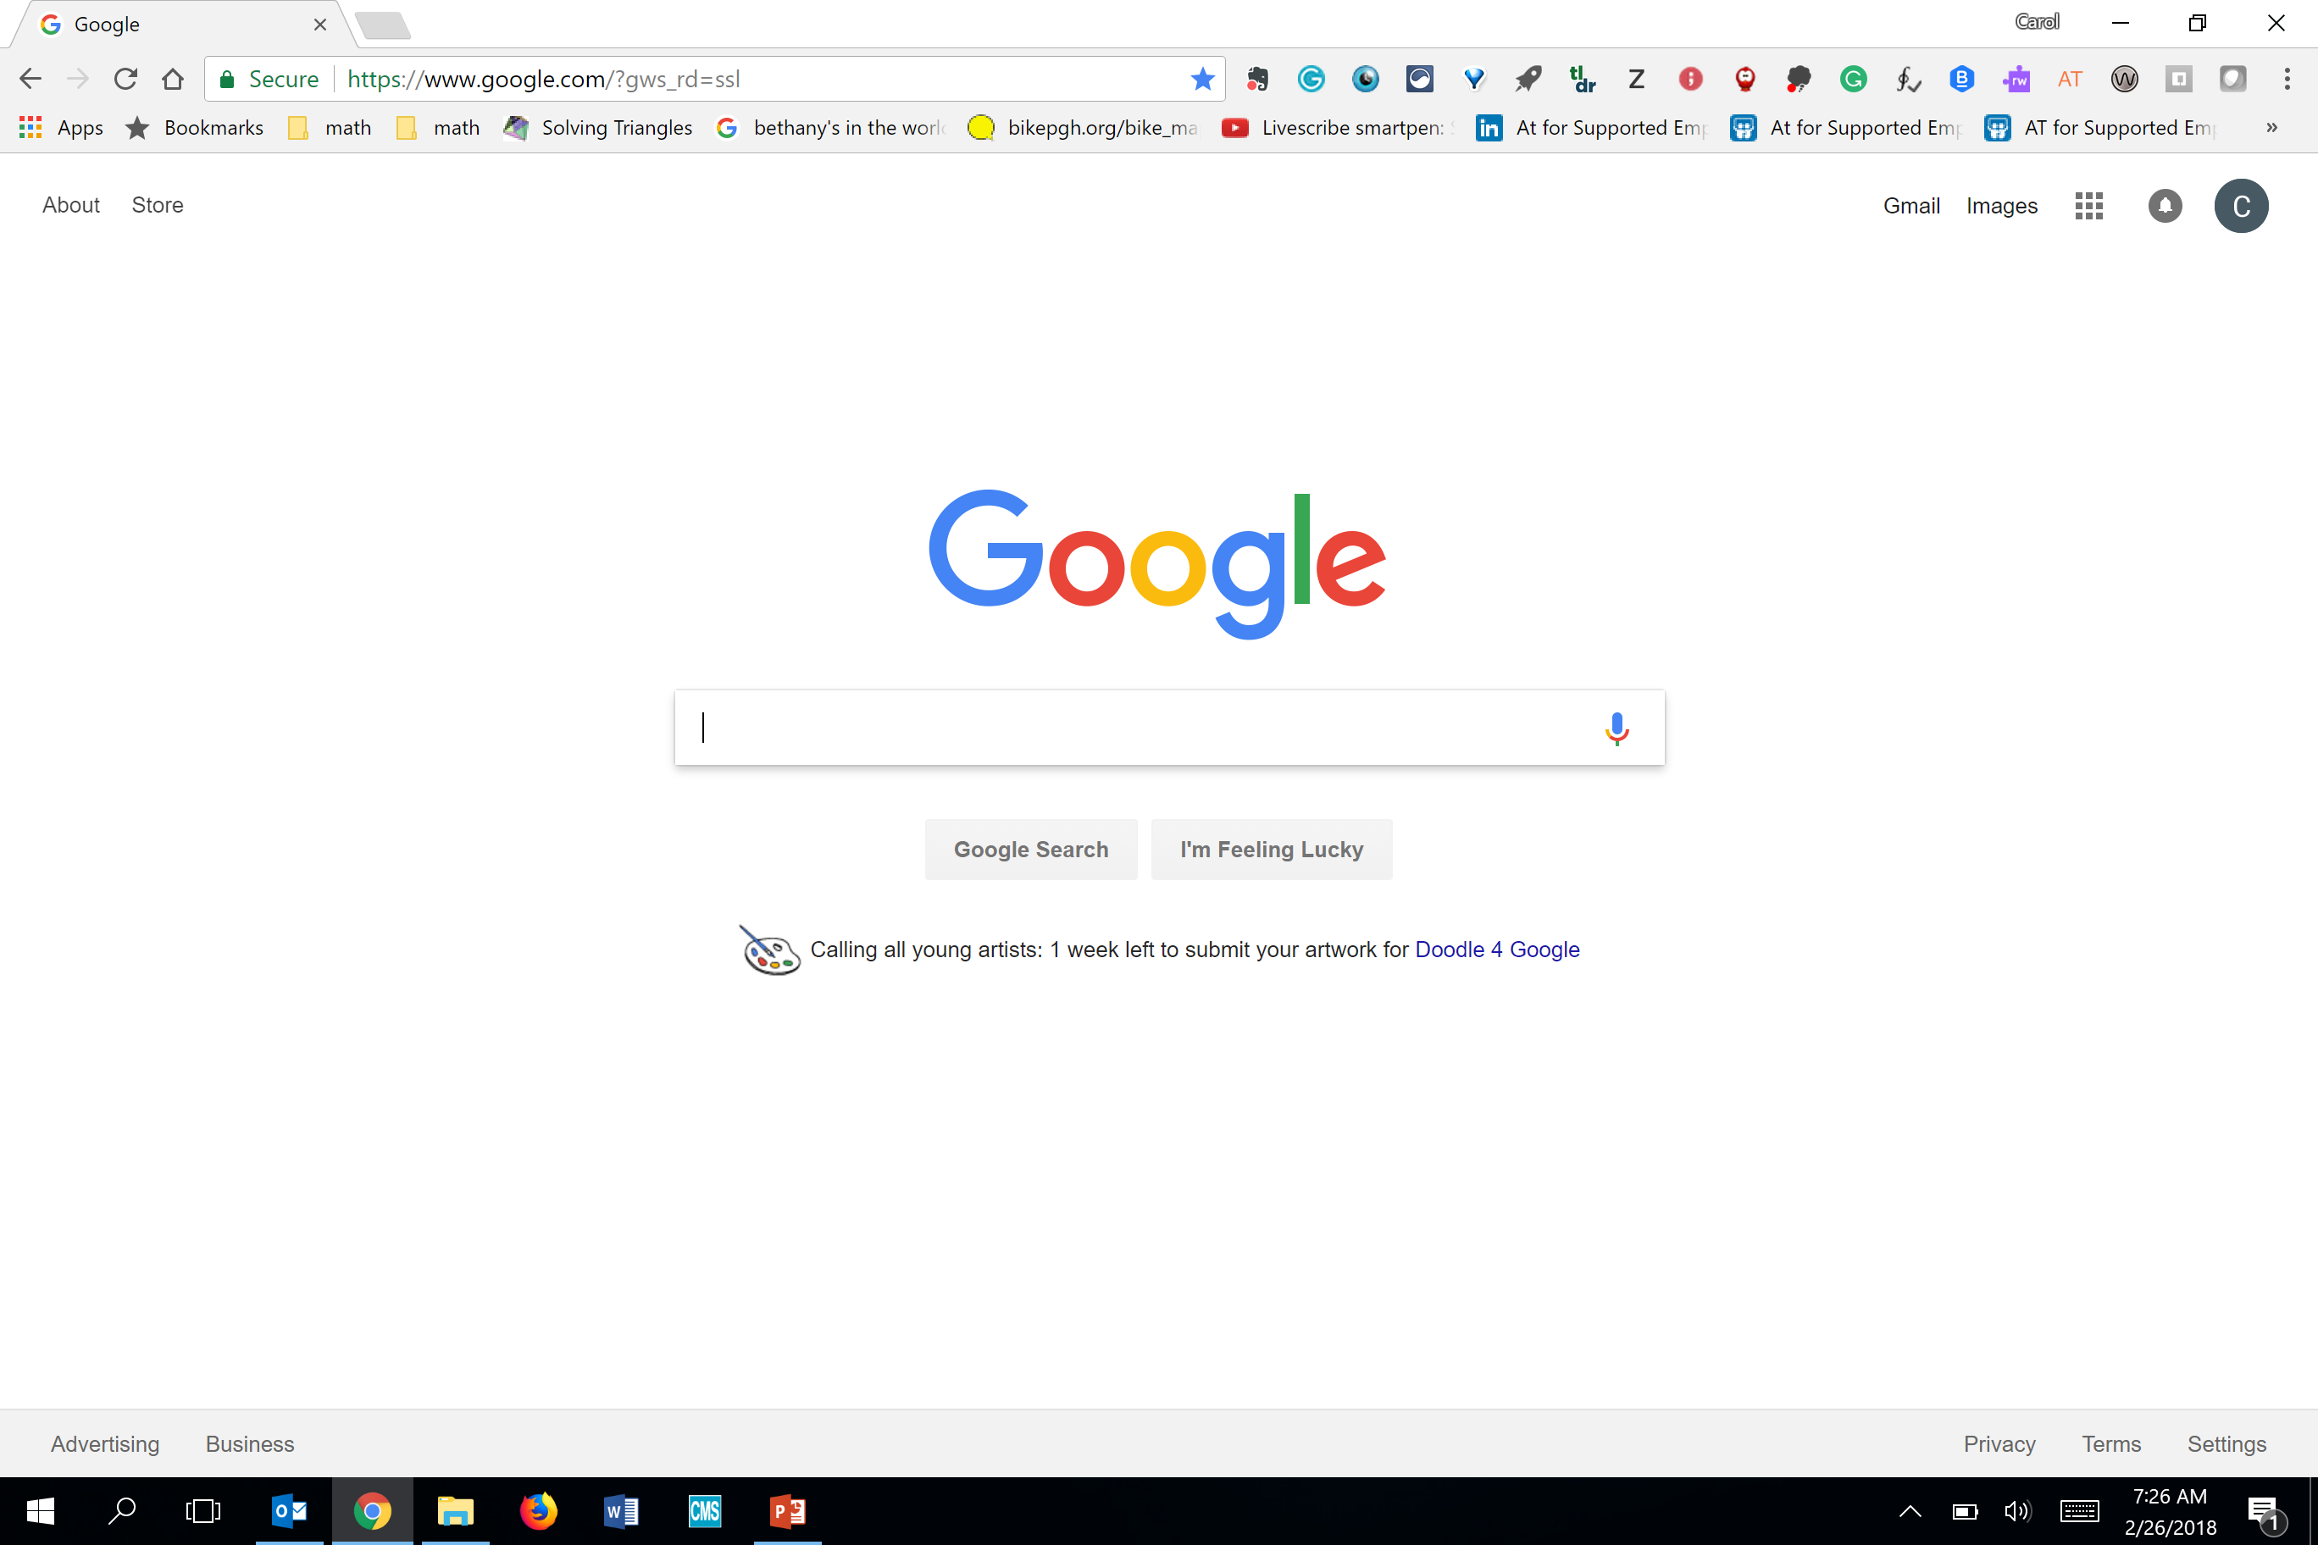
“White” space
Notes:
Which brings us to busy pages and white space. A page that has so much information that it all has to be close together with little white space can be confusing.
White space is an important concept in making a page readable and usable by everyone – white space is a common design element that can be used to: increase the legibility of text, improve the reader’s understanding, and improve the reader’s attention to the information being communicated.
This same white space aids people with disabilities in reading as well – whether it makes it easier for a screen reader to appropriately pick up and group text or makes it so that a person with a learning disability is not overly distracted, information is more accessible when white space is an element in the design.

Slide 23
Font Size & Style
Testing how easy it is to read something based on how large the font is.
Testing how easy it is to read something based on how large the font is.
Testing how easy it is to read something based on how large the font is.
Testing how easy it is to read something based on how large the font is.
Testing how easy it is to read something based on how large the font is.
Testing how easy it is to read something based on how large the font is.
Does the font style affect the readability of text?
Does the font style affect the readability of text?
Does the font style affect the readability of text?
Does the font style affect the readability of text?
Does the font style affect the readability of text?
Does the font style affect the readability of text?
Notes:
The size of your font also makes a big difference in the accessibility of your document. On the left you can see the same sentence repeated over and over again in different font sizes. It is much easier to read the larger font. There is a limit, however, to how large of a font you may want to use. When the font is too large, the information can take up too much space on the page and cause a crowding issue.
The style of font you use is also important to consider. On the right, the sentences are all the same size font, but different font styles are used. It is easiest to read fonts that are more plain – arial or times new roman are pretty standard fonts that are considered “accessible.”

Slide 24
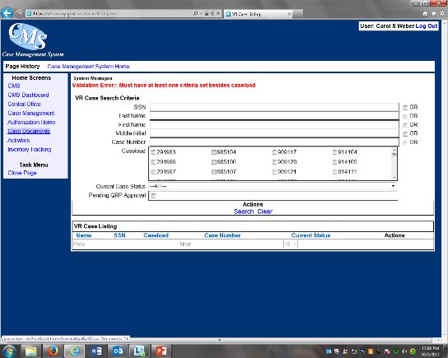
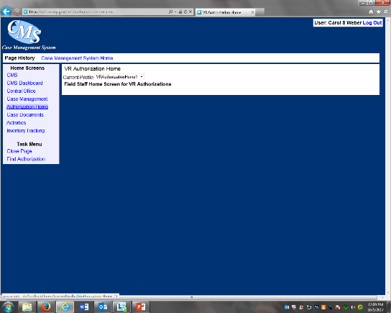
Consistent
Notes:
Another aspect of understandability is consistency. Consistency means that you can expect things to work the same way in every situation. Things have a “standard” look and feel. This can be true whether we are talking about a document, a website, a form, or the case management system. Having things work the same way all the time makes them easier to use.

Slide 25
Text Equivalents
Alternative Text Attribute (images)
  Hidden from view
  Replaces visual element for those who cannot access the visual element
  Allows an individual to perceive the information conveyed by the image
Captions
  Further visible information just above or below an image
Long(er) Descriptions
  Higher level descriptions (charts, graphs, etc)
  Include in document body, separate page, appendix/reference
Notes:
Graphics and images on documents need to have text equivalents. They are hidden from the view of the reader, but the text equivalent replaes the visual element for those who cannot access it. They can still get the information conveyed by the image.
Captions placed just above or below an image can also convey the information about what is in the graphic.
There are also longer descriptions that can be used for more complex information. This information is often included in the document body, on a separate page, or as an appendix or reference.

Slide 26
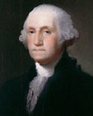
Text Equivalents – Alt Text
Context is everything
  The alt text for one image may be drastically different based upon the context and surroundings of the image itself
Notes:
Take, for instance, the following image of George Washington:
The alternative text for this image might change immensely based upon context, as demonstrated
Example 1:
Because of his role as the Commander in Chief of American forces in the Revolutionary War, and, later, the first President of the United States, George Washington is often called the "Father of his Country".
What would be appropriate alternative text for the image in Example 1?
"Image of George Washington"
"George Washington, the first president of the United States"
An empty alt attribute (alt="") will suffice.
"George Washington"
Example 2
Because of his role as the Commander in Chief of American forces in the Revolutionary War, and, later, the first President of the United States, George Washington is often called the "Father of his Country".
What would be the appropriate alt attribute for the image in Example 2?
"George Washington"
An empty alt attribute (alt="") will suffice.
"Image"
The image does not need an alt attribute.
Example 3
George Washington (Image linked to Wikipedia entry for George Washington)
What would be the appropriate alt attribute for the image in Example 3?
An empty alt attribute (alt="") will suffice.
"Wikipedia entry for George Washington"
"Read More"
"George Washington"

Slide 27
Links
Link text should make sense out of context
Avoid “Click Here”, “Read More”, etc.
Notes:
Many times, users of screen readers will be able to access a list of links on a page. For this reason, it is important that the link should make sense out of context. That means avoiding such links as “click here” or “read more” because the screen reader user would have no idea what they were “clicking here for” or what they would be “reading more about”.

Slide 28
Links - Inaccessible
https://www.katsnet.org/services/ramps/formbuilder/form.php?form_id=8u4903v5789034n85903485j90458n90nb4938w=9-n8943
Notes:
Long links that are made up of many letters and numbers that don’t make any logical sense should also be avoided.
You may think –wait a minute – the whole point of what I am trying to do is to tell someone how to get to my page – how can I do this other than by spelling out the exact link?
The link on this page leads to a form to request a portable ramp.

Slide 29
Links - Accessible
Fill out our form to request a portable ramp
Notes:
If the link is in an electronic document, often times you can substitute real words on the display and the background information will take a person who clicks on the link to the proper page.
This link allows the user to see that clicking on it will allow them to request a portable ramp.

Slide 30
Links
Fill out our form to request a portable ramp
(https://www.katsnet.org/services/ramps/formbuilder/form.php?form_id=8u4903v5789034n85903485j90458n90nb4938w=9-n8943)
Fill out our form to request a portable ramp
(goo.gl/FGH6Bx)
Notes:
It may be important to provide both methods – an understandable link like “request a portable ramp” and also the link spelled out.
In this case, it would be more accessible to use a “shortened” URL to link to the page. If someone is trying to remember or copy and paste the link – the shortened URL as shown in the second example is easier to use.
Read the first long URL and second shortened URL

Slide 31
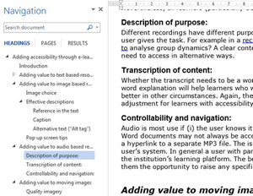
Structure
Accessible Documents – especially long documents – have “structure” to allow easy navigation.
Notes:
Many people can benefit from a “structured” document. Using structures, such as headings in Microsoft documents allows the reader to navigate the document without scanning the entire thing. Using headings also allows a screen reader user to navigate between sections of a document without having to listen to the entire document. We will demonstrate this later.
A table of contents that allows one to link to the different sections of a document can also help. Using the built-in table of content generator can assist with ensuring accessibility of the table of contents.

Slide 32
Some Common Mistakes

Slide 33
Backgrounds on documents
Contrast
Busy – ness
White space
Notes:
There is a tendency, when we develop documents that are not technical reports, to make the documents visually appealing. There are good reasons for this – for example, the design of the document may make it more noticeable to an individual and therefore they are more likely to read it. Another reason may be that a document that includes pictures and graphics may be more accessible to a person with a learning disability who would overlook plain black text on a white background as it is difficult for them to process written text.
Accessibility does not mean that we have to have everything be black print on a white background and we have to eliminate the visual appeal. Visually appealing documents can be as accessible as plain documents. Accessibility does mean that we must consider our use of visual elements and how they add to the information that we are communicating and how they will be accessed by people who don’t see.
One of the things that we should look at is the background of our documents – is it so busy as to be distracting to the reader? Is the contrast between the text and information on the page large enough that I can easily see and read it? Is there actually enough background to make the information stand out?

Slide 34
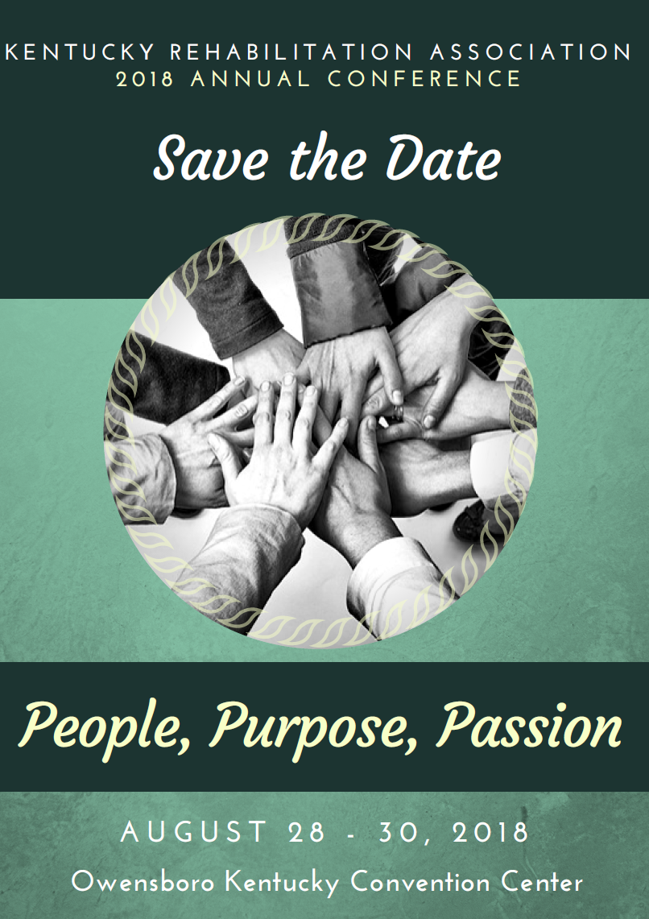
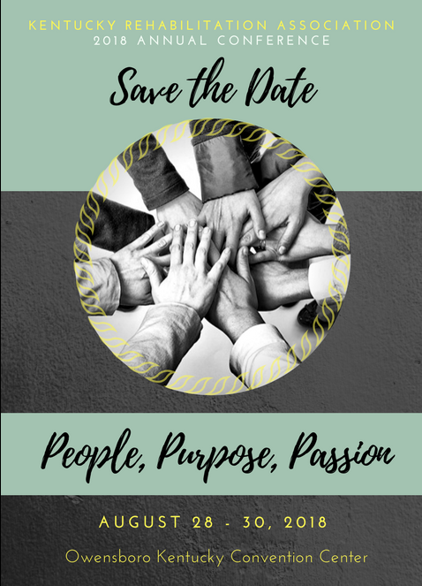
Background - contrast
Notes:
These two documents have a very similar look and feel. The document on the left, however, is actually more accessible. The contrast between the writing and the background is better, in general. Additionally, the font chosen is easier to read on the left document than on the right document.
While ease of reading may be different for each person, the one on left is actually more accessible to a screen reader. When a screen reader tried to read the one on the right, it completely missed the top two lines and all the text in the cursive font. The screen reader was able to read all the print on the one on the left.

Slide 35
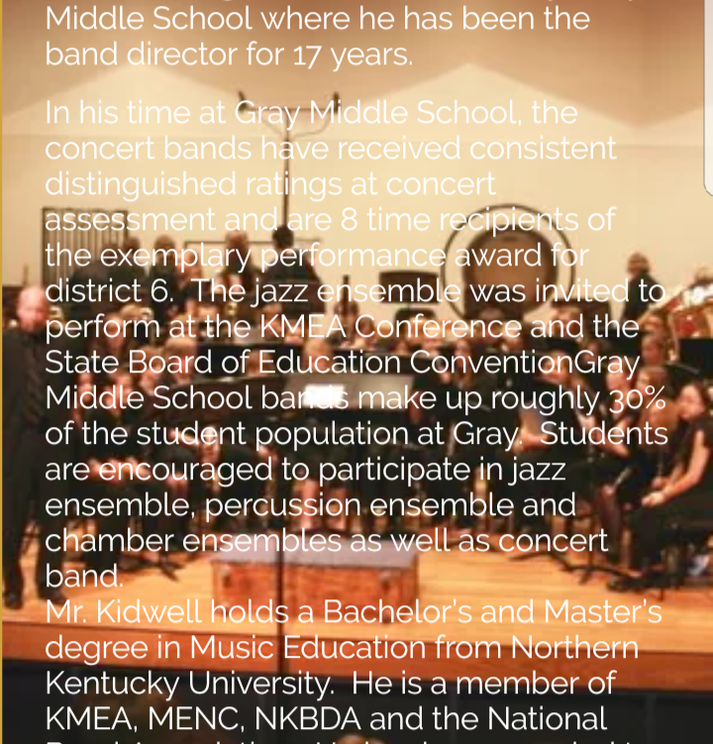
Picture backgrounds
(Just in case you were ever tempted to put text that you actually wanted people to be able to read over a picture.)
Notes:
Background is so important – not just color contrast – but busy-ness of the background. Some parts of this webpage have good contrast, but it is just too difficult to see most of the text.

Slide 36

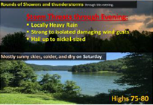
Text that is a “picture”
Sometimes, what is on the page “looks” like text – in that I can, as a sighted person, read the text.
When the text is actually a “picture” of text, it is much more difficult to read for a person using a screen reader.
It’s not that you can’t use “fancy text”, but the picture must have a text-equivalent.
The software used to generate the fancy picture with embedded text may allow you to type the text in, but when you save it, it saves as a picture.
Notes:
One frustrating error that people make is adding text to a picture and then saving that document as a picture. Everything then becomes a picture and there is no text associated with it.
To the sighted person, this looks like text on a picture, but a screen reader doesn’t differentiate between the text on the picture and the picture itself.
The solution to this problem is to use alt – text. But, not everyone who has a disability has access to alt-text. So, even when using alt-text, you have to make sure that there is enough contrast, the font style and size are appropriate, and the background is not so busy as to make reading the text difficult.

Slide 37
Accessibility Checker
Use it!
Checks for things like:
  Images or graphics without alternative text
  Links that are not plain language
  Use of structure
Notes:
Microsoft actually, with all of its software, provides an “accessibility checker” that can catch some common mistakes, like images or graphics without alternative text, links that are not in plain language or long documents that have no structure.
This is an easy way to start looking at basic accessibility.

Slide 38
Example of Accessible and Inaccessible Communication
When using a screen reader to read documents

Slide 39
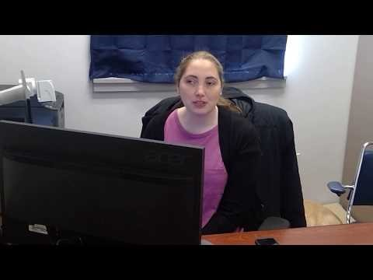
Meet Sam Farthing
Notes:
Sam Farthing will introduce herself and tell us about the assistive technology she uses. She will be participating in the webinars to show us how she can access documents of different types.

Slide 40

Using JAWS with an inaccessible document
Notes:
This video shows Sam trying to find information on the Family and Medical Leave Act in the employee handbook. I think after watching this video you will understand some of the issues that she experiences with inaccessible documents.

Slide 41
Problems Sam encountered with the Inaccessible Document
Employee Handbook
  Untagged document – Adobe Reader is going to try to figure out what in the document is text and what is not, and then also determine the order in which the items will be read.
  Difficult to navigate to the page with FMLA information because there are no links in the table of contents.
  Link to the Department of Labor poster is difficult to understand
  Poster itself is actually part of the document on a following page and this is not noted
FMLA Poster
  Another untagged document
  No navigation
  Difficult to get JAWS to move off the graphic
Notes:
Time – one of the things that is most valuable to us in our jobs as we all seem to have too much to do in too little time. And time is what it takes for Sam to access the information on FMLA – extra time, as you can tell, versus someone who can skim through the employee handbook and find exactly the right page of information. What takes this extra time?
The Employee Handbook is an Untagged document – Adobe Reader has to try to figure out what in the document is text and what is not, and then also determine the order in which the items will be read. It is also difficult to navigate to the page with FMLA information because there are no links in the table of contents. This means that Sam must search for the information instead of being able to link right to it. Sam is able to follow the link on the page to the Department of Labor poster, but it is difficult to understand exactly where the link is taking her.
The inaccessibility of the employee handbook is compounded by the fact that the DOL document is not accessible.
It’s also frustrating to realize that the poster itself is actually part of the document on a following page and this is not noted. Sam could have avoided having to open another document in another software entirely if she had realized she could get the same information in the handbook.
The DOL FMLA Poster is another untagged document, so there is no navigation. It is also difficult for Sam to get JAWS to move off the graphic to access the information. It would be easy to give up after hearing “graphic” so many times. Screen reader users become accustomed to the frustrations of not having immediate access to information, but should they have to?

Slide 42
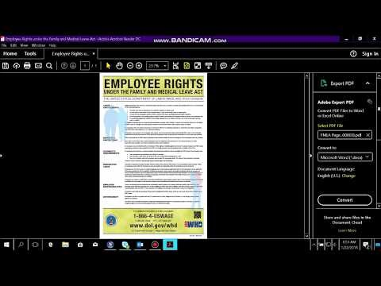
Using JAWS with an accessible document
Notes:
This video shows how accessing an “accessible” version of the same document works. You can see that Sam is much more able to access the information quickly.

Slide 43
The accessible document
Document is tagged, so JAWS understands the basic structure and the reading order.
JAWS can ignore the graphics which do not provide any information
Document can be navigated by headings – so the user can jump to the information she wants rather than listening to the whole thing.
TIME is saved.
Notes:
What makes this document more accessible:
The document is tagged, so JAWS understands the basic structure and the reading order.
JAWS can ignore the graphics which do not provide any information.
The document can be navigated by headings – so the user can jump to the information she wants rather than listening to the whole thing.
The end result is that TIME is saved.

Slide 44
But, it’s not my job!?
Yes it is.
Accessibility of Communication is a LOCAL issue. It starts with the generation of the information.
We know that people need to be trained and need support from upper level management.
We know that there are systematic changes that need to take place to become fully accessible in our communication.
You can do the “easy stuff” right now.
Notes:
If you are thinking, “it’s not my job.” Well, yes, it is your job. Accessibility is a local issue because it starts with the people who generate the documents.
I know that training and support from upper level management is an important part of accessible communication. And I know that we don’t have control over all the documents we use. Recently, we hired a counselor in the Florence office with a visual impairment. Her supervisor has been struggling with accessibility of documents from day one with this employee – accessibility of things not in her control. The State Employee Handbook, the time sheet, the emails that come in the form of pictures from the cabinet. I believe we are making a difference at the state level by increasing awareness of the need for accessible documents and by actually helping the state to generate and obtain accessible documents.
But, you can make a difference right now. You can start by doing the easy stuff in your daily work.

Slide 45
“Easy Stuff”
Make the decision that your communication will be accessible; start with accessibility in mind, not as an afterthought.
Learn the basic premises of accessibility.
Learn some basic tools in the software you most commonly use.
Implement accessibility. Start Now.
Notes:
What is the easy stuff?
First, just make a decision that your communication will be accessible.
Learn the basic premises of accessible communication. That’s what we just talked about: Perceivable, Operable, Understandable, and Robust.
Learn some basic tools you can use to make the documents you currently generate accessible – that’s what our next several webinars in this series will cover.
And finally, implement accessibility. Take what you learn today back to your office and use it. Start now.

Slide 46
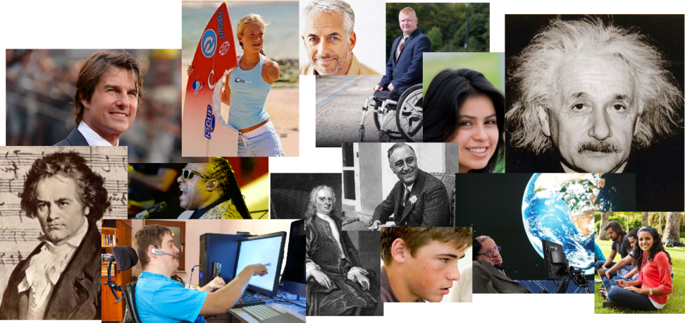
Who are you leaving out?

Slide 47
Questions?

Slide 48
Thank You
KATS Network
(800) 327-5287
www.katsnet.org
www.katsnet.at4all.com

